Slide 1




WARRIORS
HACKTOBERFEST 1.0

Slide 2



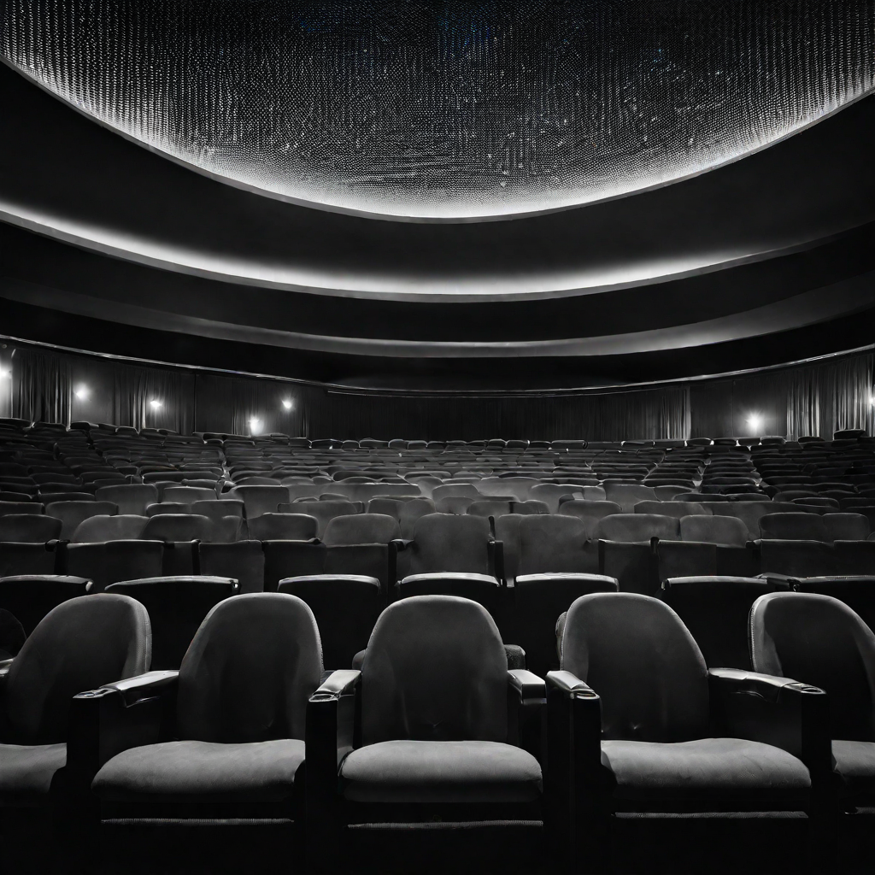


Problem statement
This project aims to develop a movie recommendation system that utilizes user input, such as a movie that they like, to provide tailored movie suggestions. The system enhances user satisfaction by offering personalized recommendations, streamlining the movie selection process, and promoting content discovery. This, in turn, increases user engagement, saves time, and improves the overall movie-watching experience.

Slide 3




Solution
Our solution involves building a movie recommendation system using the TMDB (The Movie Database) API and Streamlit in Python. Users input a movie they like, and the system recommends similar movies by analyzing genre, ratings, and other relevant data from TMDB's extensive database. Streamlit provides a user-friendly interface for input and displays the recommended movies. This approach enhances user satisfaction by delivering tailored movie suggestions and promoting content discovery, all through an easy-to-use web application.

Slide 4

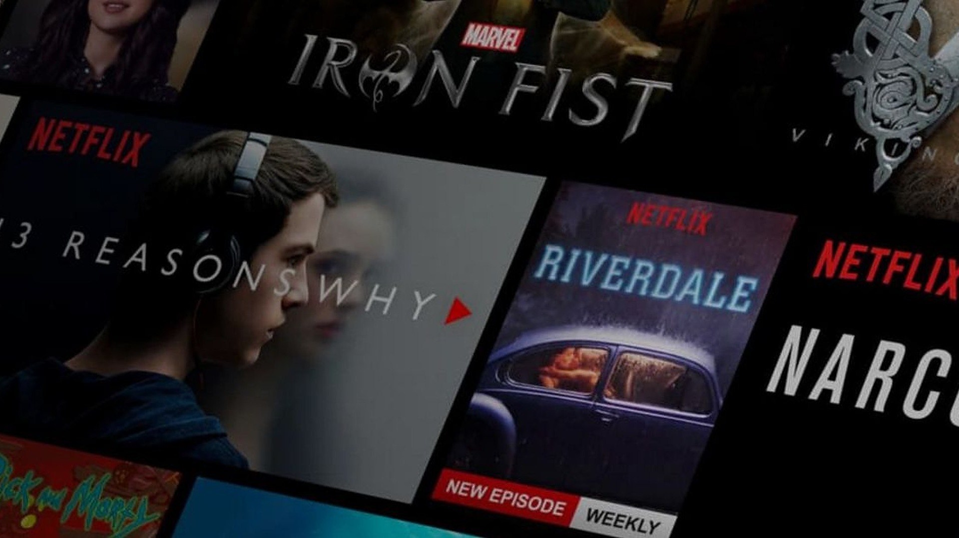
Key Features and Functionality
This movie recommendation system, powered by the TMDB database and Streamlit in Python, allows users to input a movie they like. It then leverages this input to recommend similar movies, considering factors like genre and ratings. The user-friendly web application encourages content discovery while providing movie details and the option for user feedback. The system continuously refines its recommendations, making it a personalized and efficient tool for discovering new movies that align with individual preferences.

Slide 5


Social impact
This movie recommendation system contributes to society by offering diverse and tailored movie suggestions, fostering cultural awareness, and reducing decision fatigue. It democratizes access to quality entertainment, benefits the film industry, and encourages content discovery. Ultimately, it enriches people's leisure time and supports a more inclusive and vibrant film landscape, making a positive social impact.

Slide 6


Revenue Model
The revenue model for this movie recommendation system can include a combination of strategies. These may encompass subscription tiers with premium features, advertising partnerships with movie studios, and affiliate marketing with streaming platforms. Additionally, data monetization by providing insights to the film industry could generate revenue. By continuously improving the recommendation algorithm, the system can attract a user base willing to pay for enhanced content discovery, while also capitalizing on advertising and data-driven revenue streams.

Slide 7



Technologies Used
OUR TEAM UTILIZED A VARIETY OF TECHNOLOGIES INCLUDING PROGRAMMING LANGUAGES LIKE PYTHON, AND USED STREAMLIT PACKAGE IN PYTHON TO CREATE A USER INTERFACE AND DEPLOY IT.

Slide 8




The Team
Venigalla Kowshik Eswara Chaitanya
Dhulipala Siva Tejaswi
Tirumalasetty Veera Naga Aditya

Slide 9


Thank You
HACKTOBER FEST

